Slide 1

American Imperialism: Pacific Theatre Tactical Decision Game

Slide 2
Objective:
Cadets will evaluate the friction between political strategy ( “Benevolent Assimilation”) and tactical reality (Counter-Insurgency/COIN) by analyzing conflicting orders during the Philippine-American War (1899-1902).

Slide 3
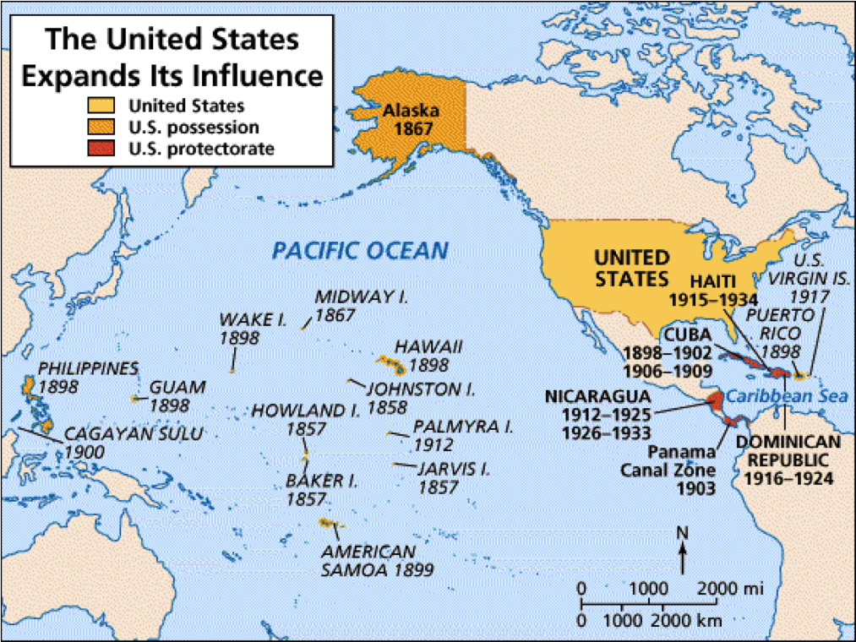
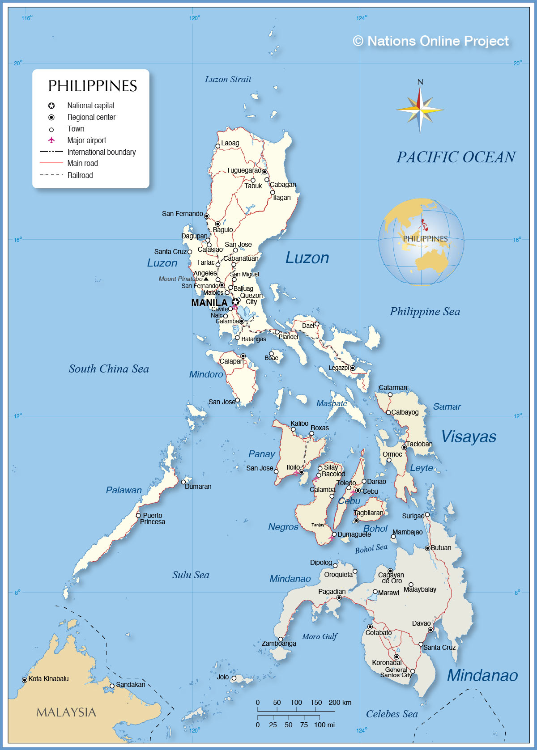
Phase 1: The Strategic mission
Notes:
Briefing: It is December 1898. The Spanish fleet is destroyed. Spain has ceded the Philippines to the U.S. for $20 million. You are the theatre commanders in Manilla. Washington has issued your strategic guidance.

Slide 4
Phase 1: The Strategic Mission
Source: President William McKinley, Benevolent Assimilation Proclamation, December 21, 1898.
Read the primary source handout. 5 minutes.
Command Question: Based only on this document, what are your Rules of Engagement (ROE)?
Notes:
Expected answer: Restrictive. Minimal force. Focus on “winning hearts and minds.”

Slide 5
Phase 2: The Intelligence failure (The “Ground” reality)
Source: General Arthur MacArthur II, Testimony to the U.S. Senate (1902)
"We are not fighting a 'faction' as has been represented... we are fighting a people who are animated by a love and affection and a gratitude [toward the insurgency] such as no one people on earth ever yet felt for another...
The towns were apparently peaceful... [but] the whole population has been acting upon the conviction that the [insurgent] army is the expression of their political institutions.
We have got the hatred and sullen submission of a subjugated people... There is not a man in these islands who is not conspiring against the Government."
Notes:
Fast forward to 1900. Your ‘Friendship’ strategy isn’t working. Convoys are ambushed. Villagers claim neutrality by day but lay IEDs (punji pits) by night. General Arthur MacArthur (Military Governor) delivers this assessment to the Senate.”

Slide 6
Phase 2: The Command Question
The Clausewitzian Problem: MacArthur identifies the “Center of Gravity” as the entire population. If your orders are to “win affection,” but the population is united against you, is the mission achievable?
Do you request new orders, or do you adapt your tactics?

Slide 7
Phase 3: The Crisis & The Unlawful order
Source: Testimony of Major Littleton Waller, Court-Martial of Gen. Jacob Smith (1902).
Gen. Smith: "I want no prisoners. I wish you to kill and burn; the more you kill and burn the better it will please me. I want all persons killed who are capable of bearing arms in actual hostilities against the United States."
Maj. Waller: "I would like to know the limit of age to respect, sir."
Gen. Smith: "Ten years of age."
Gen. Smith: "The interior of Samar must be made a howling wilderness."
Notes:
Briefing: September 1901. Balangiga Massacre. Company C, 9th Infantry is surprised while eating breakfast. 48 Americans are hacked to death. The public demands a response. General Jacob ‘Hell-Roaring’ Smith arrives in Samar and issues verbal orders to Major Littleton Waller (USMC).”
Discussion Prompt: You are Major Waller. You are a Marine officer. You have just received this direct verbal order from an Army General.
Questions:
1.) The Ethics Check: Do you follow the order? (Waller did not kill children, but he did execute prisoners and burn villages).
2.) The Leadership Dilemma: If you refuse, you risk insubordination in a combat zone. If you accept, you commit war crimes. What is the correct course of action for an officer?
3.) The Strategic Blowback: How does Smith’s order (once leaked) affect McKinley’s original goal of “Benevolent Assimilation”?
Debrief:
-Tactical vs. Strategic: While Smith’s brutality “pacified” Samar tactically, it was a strategic disaster that fueled the Anti-Imperialist League back home.
-Modern Parallel: This is the same dilemma faced in Vietnam (My Lai Context) and recent conflicts in the Middle East. The question “who is the enemy?” remains the hardest question in asymmetric warfare.

Slide 8
After action report: Philippine insurgency (1899-1902)
The Human Cost
U.S. Forces: ~4,200 killed; ~2,800 wounded. Note: More died from disease than combat.
Filipino Combatants: ~16,000-20,000 killed.
Filipino Civilians: Estimated 200,000+ dead. (Primary causes: Cholera epidemics exacerbated by war, famine, and “reconcentration” camps).
Legal and Disciplinary Outcomes
Brigadier General Jacob Smith: Court-martialed for “conduct to the prejudice of good order and discipline.”
Verdict: Guilty.
Sentence: Admonished and forced into early retirement. (many Anti-Imperialists viewed this as a “slap on the wrist”)
Major Littleton Waller: Court-martialed for the execution of 11 Filipino porters without trial.
Verdict: Acquitted. The court ruled he was acting under Smith’s direct orders and the extreme duress of the campaign.

Slide 9
After Action REport
Strategic Result
Military Victory: The insurgency was officially declared “over” on July 4, 1902.
Policy Shift: The U.S. eventually pivoted away from pure military coercion to the “Policy of Attraction”—winning support through infrastructure, public education, and eventual self-governance.
Lesson Learned
The Paradox of force: Excessive tactical brutality (Smith) may clear a sector temporarily, but it undermines the strategic political goal (McKinley).
Independence: The Philippines remained a U.S. territory until gaining independence on July 4, 1946.

Slide 10
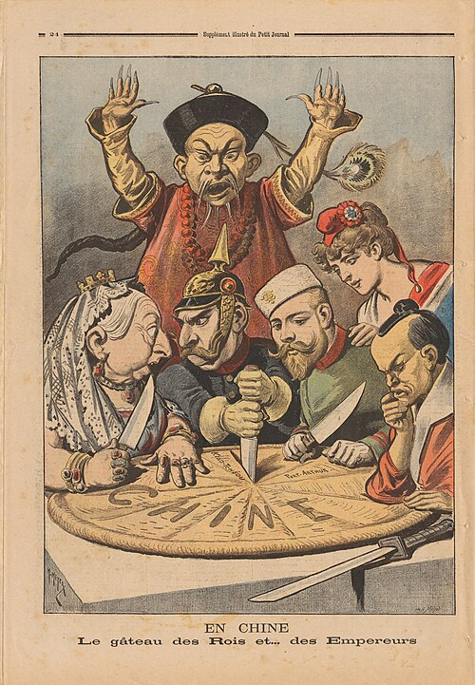
The “Open Door” Policy
Notes:
Q: Why did we just spend three years fighting a brutal insurgency to keep the Philippines? Was it for Philippine coconuts?
A: No. It was for China. The Philippines was the “coaling station” to get U.S. goods into the massive Chinese market.
Image: “China, the Cake of Kings” (Henri Meyer, 1898)
What do you see in this image? Queen Victoria, Kaiser Wilhelm II, Nicholas II, and the Meiji Emperor. Chinese official is protesting but ignored.
The problem: The U.S. is not at the table. We arrived late in the imperial game. If China gets carved into colonies like Africa, the U.S. gets locked out of the market.

Slide 11
The “Open Door” Policy
Source: Secretary of State John Hay, First Open Door Note (1899)
"[The United States requests that each nation] within its respective sphere of whatever influence... shall apply to the commerce of all nations the Chinese treaty tariff... and that no higher railroad charges or harbor dues shall be levied on [American] merchandise than are levied on its own nationals."
Notes:
The Trap: None of the European powers wanted to agree to this, but none of them wanted to be the first to say ”No” and look like the greedy villain in front of the U.S.
The Response: They all sent vague, non-committal replies like, “We agree in principle, depending on what Russia does…”
Hay’s Move: John Hay publicly announced that everyone had agreed. He accepted their “maybe” as a “yes” and declared the policy active. It was a bluff that became reality because no one wanted to challenge it.
Final Takeaway: In 1898, the U.S. became a world power using Hard Power (the Navy) to take the Philippines. In 1899, it secured its economic future in China using Soft Power to open the door. Modern U.S. strategy requires both.

